Slide 1
Participatory Archival Research and Development in Action:
Updates from DLF’s BDAWG
Alston Cobourn, East Carolina University
Jess Farrell, Educopia Institute

Slide 2
PAR&D
Notes:
Participatory Archival Research and Development (PAR&D) is a framework for research in practice that emphasizes the processes of development and action over passive research to further understanding and make progress in our profession.
In their recent article, Clemens, Hagenmaeir, Meyerson, and Appel draw from Renee Jefferson’s interdisciplinary study of “participatory action research” that applies the participatory action research approach to libraries. Jefferson ties the origin of PAR to the early 20th century work of Kurt Lewin, whose approach includes “reflection and inquiry with an emphasis on improving one’s work environment.” In Jefferson’s thorough review of Participatory Action Research, they examine how this type of research has slightly different contexts or outcomes depending on the field, but always has a goal of improving working conditions by solving problems that impede practitioners’ work.
The authors also bring in their own repertoire of interdisciplinary research frameworks such as translational research, research-in-practice, and research & development, and cite this Research Forum as a critical space for different types of research explorations within the information profession.

Slide 3
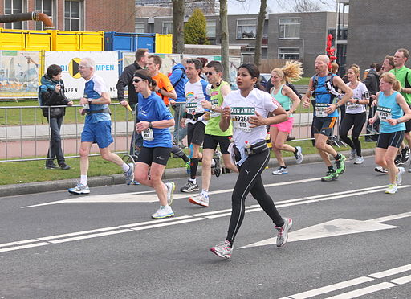
In Action
Image courtesy Peter van der Sluijs, https://commons.wikimedia.org/wiki/File:Running_people_during_marathon.JPG
Notes:
And today we’re going to talk about how this theory is in practice in the DLF Born-Digital Access Working Group, or affectionately known as BDAWG. So you’ll learn about our research progress over the past year while seeing how it fits into this framework.
For some background - the energy to convene DLF BDAWG was generated from the hackfest at SAA ‘16 and ERS blog posts that was developed by the Clemens, Hagenmaeir, Meyerson, and Appel, and are described in the article. Some people who worked on one project produced during the hackfest, “Bootcamp for born-digital access,” organized a born-digital access working lunch at DLF following the first bootcamp, and a lot of people showed up ready to discuss. By the end of the working lunch we had a project to work on and the will to start a DLF group. Through DLF BDAWG, we bring librarians and archivists together to consider how we improve digital access for all collections, not just the electronic resources and digitized collections that are considerably easier to provide access to - or at least where good access practices are better modeled and understood.
And all of our projects so far are PAR&D in action. For example:

Slide 4
Participatory
Low barrier of entry
Inclusivity
Foster a culture of consent
Notes:
These are characteristics of being Participatory that BDAWG is exemplifying.
The barrier of entry to BDAWG is very low. All that is required is reaching out to the group and expressing a desire to join. We try to foster a culture around consent where participants can feel that it is ok to say no if they need to step back and that they can rejoin the work when able. We are particularly proud of the low entry barrier and group culture because we think these things aren’t quite as easy to establish in all professional organizations.
We include and encourage working group members from a variety of cultural heritage institution types and sizes. We have put out the calls for feedback through channels that are widely accessible, such as organizational and regional listservs and social media. Anyone in BDAWG’s google group can participate in the group’s bimonthly meetings. Additionally, we are currently planning our first BDAWG Virtual Colloquium to be held on August 20th.
The group has made a concerted effort to document internal processes to help ensure continuity for current and future group members. This includes documentation for transitioning co-leads.

Slide 5
Archival
Reflect throughout the research, development, and practice process in order to reinforce key archival values of trust and integrity
Acknowledge and embrace that changes in archival repertoires do not follow a linear trajectory
Notes:
One principle of Archival is “Reflect throughout the research, development, and practice process in order to reinforce key archival values of trust and integrity.” This relates to the inclusivity point on the Participatory slide I just covered and to Iterative design which I will discuss on the Research slide.
In all of BDAWG’s work we acknowledge and embrace that changes in archival skillsets, tools, and education do not follow a linear trajectory. For example, this is exactly why the Born-Digital Levels of Access document contains tiered levels of access; it is recognizing that organizations will be at different places in their born-digital access journeys, with different resources, infrastructure, and limitations.

Slide 6
Research
Importance of self reflection
Iterative design
Diversify traditional ways of knowing
Create shared, participatory professional research agendas set and informed by communities beyond the boundaries of any single professional organization
Notes:
BDAWG’s belief in the importance of self reflection is exemplified in the work previously done by the Access Practices subgroup. They paused and realized the experiences of the group members are not all encompassing and thus asked users for feedback.
Within the Levels of Access subgroup, we tried often to remind ourselves of this fact and then broaden the way we were thinking about a particular point or aspect.
The Levels of Access document went through multiple iterations during its creation, each incorporating feedback from either the other BDAWG subgroup members or the archival community.
The Access Practices group tried to diversify its ways of knowing by conducting a traditional survey but also leading sessions to solicit feedback at DLF and BitCurator events.
Additionally, our research agendas have been informed by communities beyond the boundaries of any single professional organization; our BDAWG members belong to multiple organizations. We have worked to spread information about the group and its projects through multiple professional organizations not just our home one. For example, we are here speaking to you now at the SAA research forum.

Slide 7
Development
Focus on translating research results directly and quickly into practice
Nurture agile professional organizations that facilitate ad hoc groups and communities of practice
Notes:
Development within this framework calls for a focus on translating research results directly and quickly into practice. BDAWG has recognized a need to assess if and how people are using the Levels of Access document and is currently thinking about how to best do this.
By aligning with the Digital Library Federation, we are nurturing agile professional organizations that facilitate ad hoc groups like BDAWG and communities of practice. Even though the DLF hasn’t had a strong history of archival work, we decided to situate ourselves there because they do facilitate ad hoc groups well and there was a low barrier to entry for the first coordinators.

Slide 8
Current Work

Slide 9
BDAWG Current Structure: 2020
11 other cool working groups!
DLF
Born-Digital Access Working Group
Donor Relations
Legal due diligence
Documenting Access Methods
Ideal
Systems
Values
Notes:
For those of you not familiar with the Digital Library Federation, they have a pretty decentralized working group structure. We are one of 12 active working groups, and we’re excited to have 5 streams of work going at the moment.

Slide 10
Goal: develop some resource(s) for managing remote donor relations and acquisitions
Current Work: Annotated bibliography; recruiting members; planning a forum to discuss this topic
Release date: Look out for the release of the bibliography in the next few weeks!
Donor Relations
Notes:
Annotated bib/lit review is completed and will be made public soon. Not enough new information for a resource. Would like to pivot to thinking about remote on-site visits and acquisitions. New call for membership for this new topic. Start off facilitating open forum on this topic. Contact aberdini@princeton.edu to join new group focus.

Slide 11
Legal Due Diligence
Goal: create a resource that helps practitioners understand what steps are needed to provide low-risk access
Current Work: peer review on our research so far (10 areas)
Potential output: A flow chart with links out to the research we feel adds to the conversation
Release date: unknown
Attorney-client privilege
Copyright
FERPA and HIPPA
GDPR
Terms of service
PII
Privacy
Cultural sensitivity
Donor restrictions
Institutionally mandated confidentiality
Notes:
Goal: To create a resource that helps people wanting to provide access to born-digital materials take the processing steps needed to legally provide access
What we’ve learned: It’s hard to scope to just legal issues and without talking about ethics so we are struggling to scope that part. We’ve done research in attorney-client privilege, donor restrictions, copyright, cultural sensitivity, FERPA and HIPPA, GDPR, Institutionally mandated confidentiality, PII, privacy, and terms of service. Now that we have this wealth of information pulled together, we’re still teasing out what useful resource looks like, but are leaning toward a flow chart that links out to detailed info about each area.
We haven’t committed to a release date yet.

Slide 12
Access Values
Goal: Set forth a values statement for BDAWG for how we approach our work
Release date: Summer 2020
Notes:
To set forth a values statement for BDAWG for how we approach our work. We aren’t all archivists and we don’t have a charter, bylaws, etc. so this serves as an identity builder for BDAWG.
We started this project a long time ago - we’ve gone through a community feedback process and are now finalizing the document.
I’ll be released this month!

Slide 13
Documenting Access Methods
Goal: explore what elements institutions could include in a useful access policy statement
Requested feedback from larger subgroup on first draft
Current work: Refining draft
Framework sub-subgroup
Notes:
The documenting access methods group consists of two sub-subgroups.
The framework subgroup is exploring what elements institutions could include in a useful access policy statement. So far they’ve requested feedback from the larger subgroup on their first draft and are continuing to refine that draft. They hope to have something available for comment by the end of the year.

Slide 14
Documenting Access Methods
Goal: Categorize and point to existing documentation;
Current work: Prototyping form to populate spreadsheet
Pointer sub-subgroup
Notes:
The pointer sub-subgroup is working to categorize and point to existing documentation about access methods for born-digital materials. Their deliverable will be a spreadsheet, and they are currently prototyping the google form that the community will use to populate that spreadsheet.

Slide 15
Goal: define what 'ideal' access means; provide recommendations on how to create and implement ideal access systems in different contexts.
Current work:
Literature review
Functional definition of 'ideal'; mapping Access Levels and Access Values
Next stage: use the definition to build a project plan for an ideal access system
Ideal Systems
Notes:
The ideal systems subgroup is working to define what 'ideal' access means, and to provide recommendations on how to create and implement ideal access systems in different contexts.
They are currently working on two projects: a literature review of relevant articles and case-studies and finalizing a functional definition of 'ideal' and mapping the Access Levels and Access Values documents onto said definition.
They plan to move into their next stage of using the definition to build a project plan for an ideal access system very soon.

Slide 16
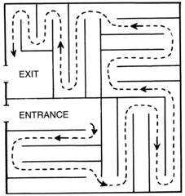
How to Find Us
You can read anything we publish at:
https://osf.io/hqmy4/
And here’s how to join us:
tinyurl.com/BDAWGGG
We aspire to build out our wiki:
https://wiki.diglib.org/Born-Digital_Access_Working_Group
Image courtesy of Pearson Scott, Foresman, https://commons.wikimedia.org/wiki/File:Labyrinth_Maze_(PSF).png
Notes:
Here’s some info about staying in the loop with what BDAWG is doing and how you can participate.

Slide 17
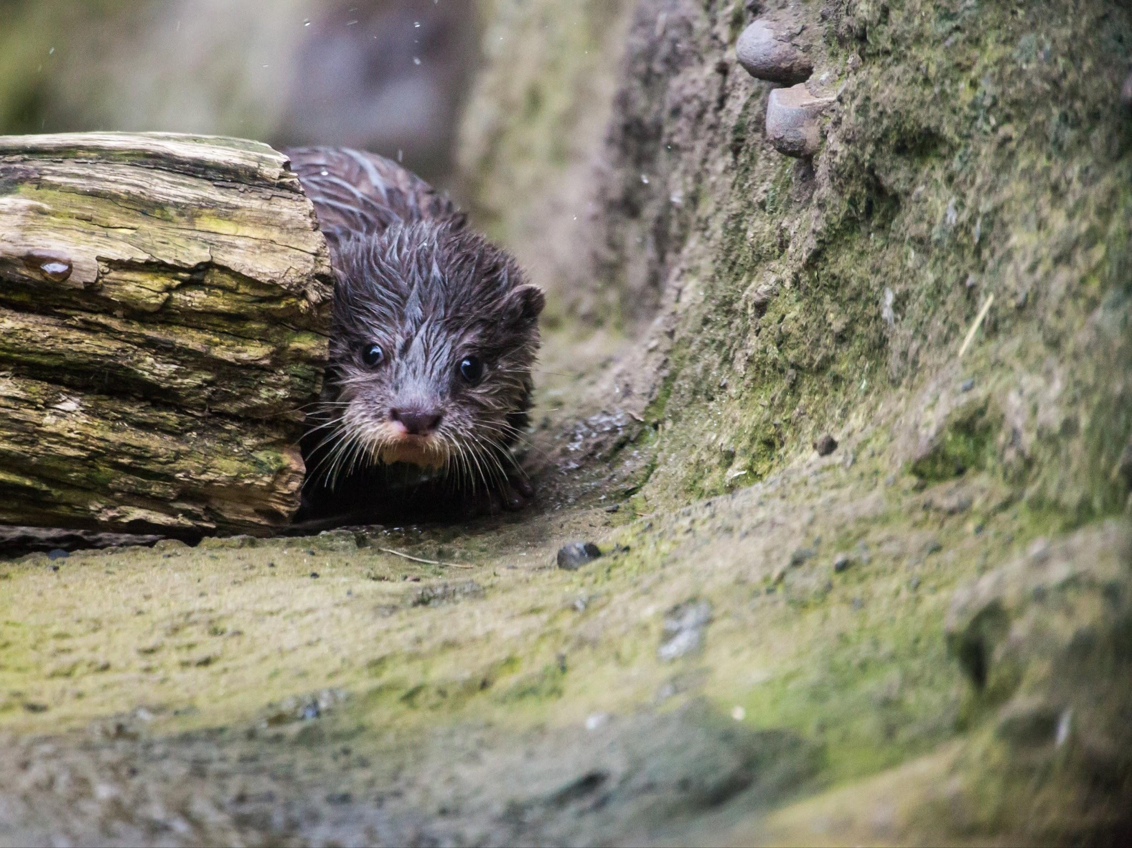
Don’t be a Stranger
Contact Info
Alston Cobourn
University Archivist, East Carolina University
cobourna18@ecu.edu
Jess Farrell
Community Facilitator, Educopia Institute
jess.farrell@educopia.org
Photo by Holger Link on Unsplash
Notes:
And here’s our personal contact info. Certainly reach out to either of us if you have questions or comments about our presentation today or about BDAWG.

